Slide 1
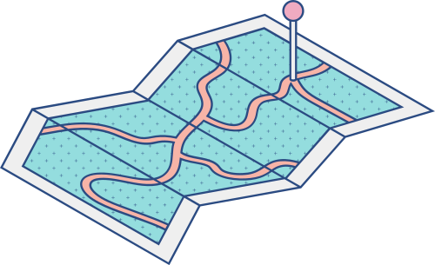





CSE428: IMAGE PROCESSING
Lane Detection using IP
Members:
Name: Mohammed Taher Abdullah
ID: 19101054
Name: Shadab Iqbal
ID: 19101072
Name: Srijan Banik
ID: 19101062

Slide 2

Motivation:
Problem Statement:
Using the fundamentals of this course to solve a problem
Understanding how to put image processing into practice
In our country, there seems to be an rise in the number of road accidents.
Casualty due to road accidents.
On the roads, there seems to be some rough driving.

Slide 3
Methodology
1
2
3
4
5
STEP
STEP
STEP
STEP
STEP
Color filtering
Finding the ROI
Detecting Canny Edges
Applying Hough Line Detection
Video Implementation
Filtering out the Yellow and White colors of the image
Masking unnecessary pixels from the image
Detecting edges of the filtered lanes in greyscale
Combining into a single line
Applying the whole process into a video

Slide 4

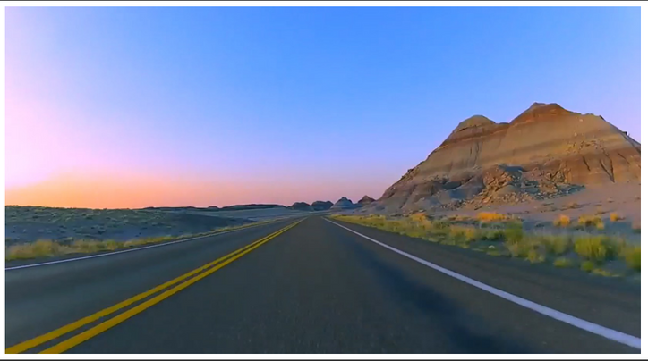
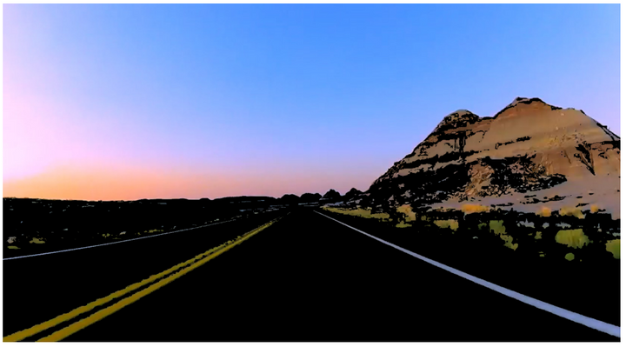
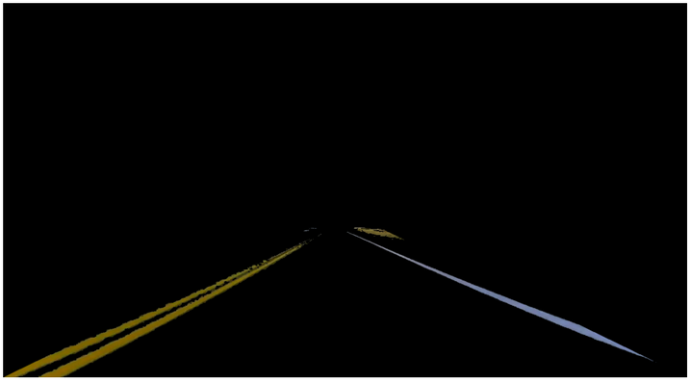

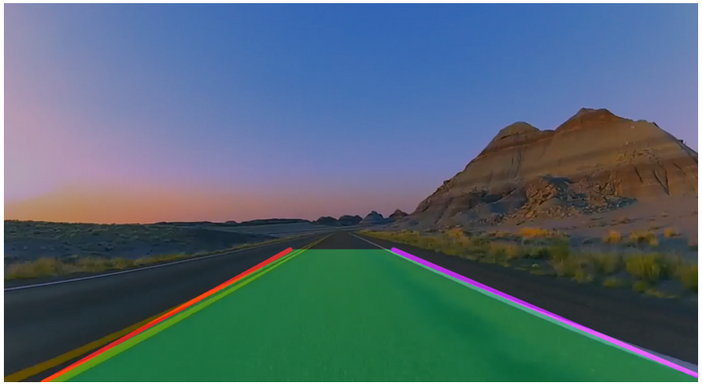
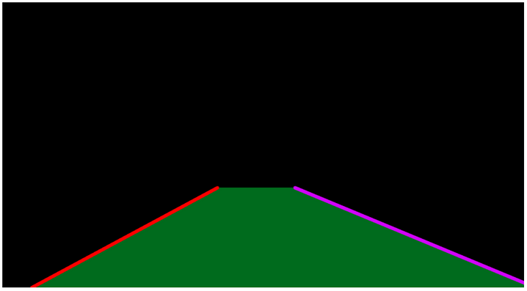
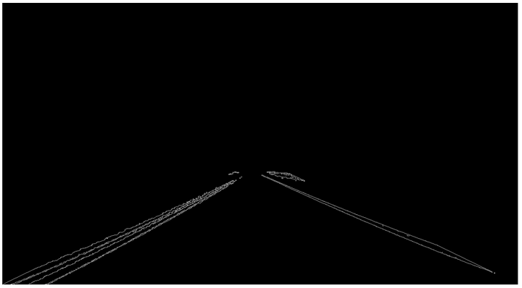
Process:

Slide 5

Result & Discussion
Visual representation of our result
After applying the process in order, we were able to integrate that to this video taken from YouTube

Slide 6
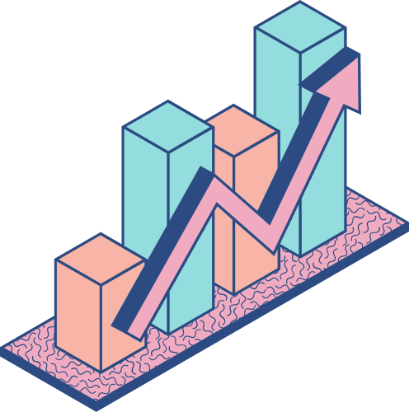
Conclusion And Possible Improvements
MARCH TOWARDS AUTONOMOUS VEHICLE
Can improve in detecting curved lanes
Detecting lanes without lane boundaries
In order for lane identification to work on every route, a neural network model can be trained.

